Slide 1
Accelerating Higher Education Expansion and Development (AHEAD) Program
by
Harsha Aturupane
Lead Economist, The World Bank
2018

Slide 2
THE WORLD BANK
Owned by about 180 countries (including Sri Lanka)
Initially established to help reconstruction of countries affected by the Second World War
Currently supports development of low-income countries (grants and soft loans) and middle-income countries (soft loans)
Focus on equity and social justice – the poor, and the bottom 40 percent of income groups

Slide 3
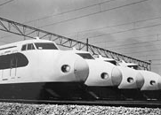
Countries Developed with World Bank Assistance Some Examples
France
Germany
Italy
Austria
Japan
South Korea
Singapore
Hungary
Poland
Czech Republic
Slovak Republic

Slide 4
Higher Education Sector Challenges
Low gross enrolment ratio in Higher Education
Shortage of qualified academic staff
Quality variation among institutions
Domination of teacher centered and passive student learning
High variation in labor market prospects and employment experiences
Less focus on research and innovation
Low level of public funding …..but improving in recent years
QAA system ………a new stage of development

Slide 5
AHEAD Operation in Support of the Sri Lanka Higher Education Development Strategy
Results Area One: Increasing Access to Higher Education in Priority Areas for Economic Development
Results Area Two: Improving the Quality of Higher Education
Results Area Three: Promoting Research, Development, and Innovation

Slide 6
AHEAD Characteristics
Operation Period : ………….to June 2023
Value : US$ 100 Million
Program for Results Instrument
Program : US$ 93 Million
Project : US$ 07Million
Results based financing
Disbursement linked indicators

Slide 7
AHEAD Investment for Higher Education in Sri Lanka
Economic and Social Development
Innovations for industry
Student Intake
Quantity and Quality of Graduates
Academic research
Investment in Higher Education
Quality of Teaching and Learning
Governance of research and innovation
Quantity and Quality of Staff
Governance of Teaching and Learning

Slide 8
Focus on Economic Contribution of Graduates
Academic quality on trust
Academic quality with public accountability
Socio-emotional skills
Blending academic excellence with socio-emotional skills

Slide 9
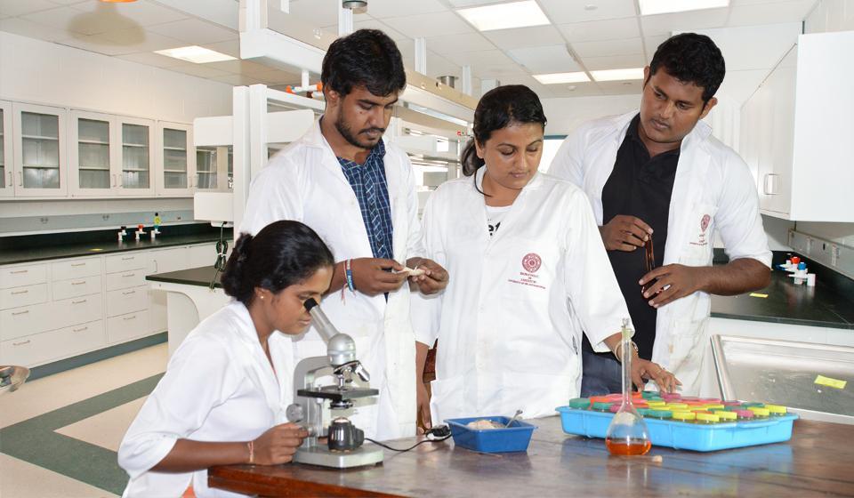
Focus on Research and Development and Innovation
Teaching universities
Research universities
Innovation universities
Blending academic research and innovations for development

Slide 10
Lessons Learned from Previous Operations
1. Mainstream operations within the government system
Management
Financing
Policy reforms
2. Focus on results and outcomes
Endogenous outcomes
Exogenous impacts
3. Provide multi-disciplinary technical support
4. Simplification of procedures
5. Inter-relationships between Results Areas

Slide 11
Support at University Level
Operations Technical Secretariats (OTS)
01
OTS Directors and staff
02
Coordinators for results and outcomes
03
Development of UBL-Cells
04

